Slide 1
Topic: Architecture and Operation of 12-bit ADC in STM32F1 Series
Presenter: Group-9
Md. Habibur Rahman | 2210376108
Nadim | 2110276119
Naimur | 2111076144
Md.Murad | 2210376102

Slide 2
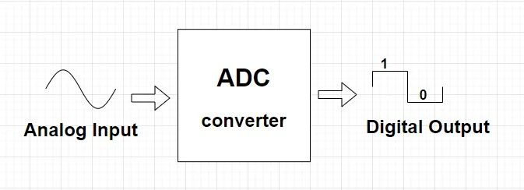
Introduction to STM32 ADC

Slide 3
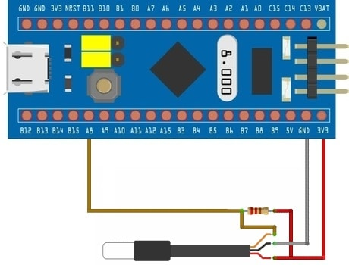
Interfacing DS18B20 Temperature Sensor with STM32

Slide 4
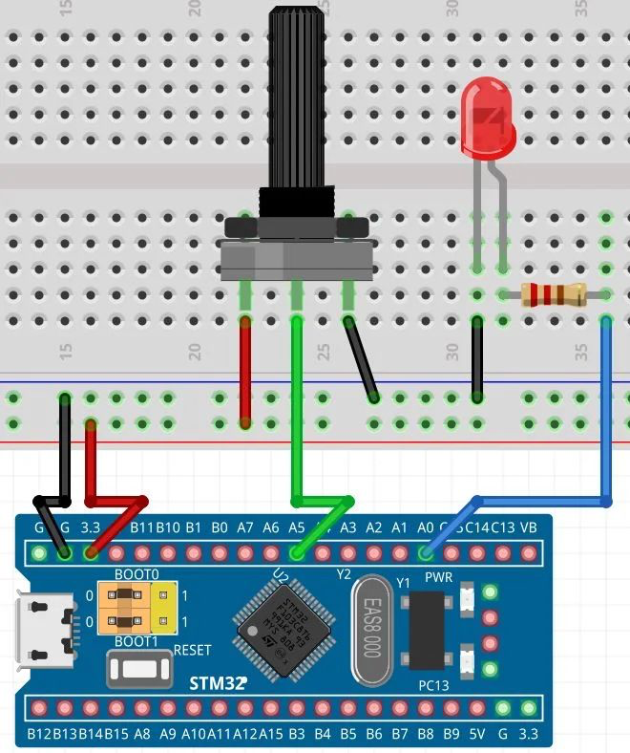
Introduction to STM32 ADC

Slide 5
Introduction to STM32 ADC
Core Logic: It is a 12-bit Successive Approximation (SAR) Analog-to-Digital Converter.
Capacity: Supports up to 18 multiplexed channels (16 external and 2 internal sources).
A/D Conversion: Converts continuous analog voltage into discrete digital values (0 to 4095).
Internal Sources: Includes dedicated channels for the Internal Temperature Sensor and Internal Reference Voltage.
Operational Modes: Conversion can be performed in Single, Continuous, Scan, or Discontinuous modes.
Data Storage: Results are stored in a 16-bit data register with configurable Left-alignment or Right-alignment.

Slide 6
Main Features
High Performance: STM32F103xx performance line devices: 1 µs at 56 MHz (1.17 µs at 72 MHz)
Wide Input Range:ADC input voltage range is VREF− ≤ VIN ≤ VREF+
ADC supply requirement: 2.4 V to 3.6 V
Self-Calibration:Built-in hardware calibration reduces internal conversion errors Data Safety:Analog Watchdog monitors input voltage and triggers an alert when limits are crossed

Slide 7
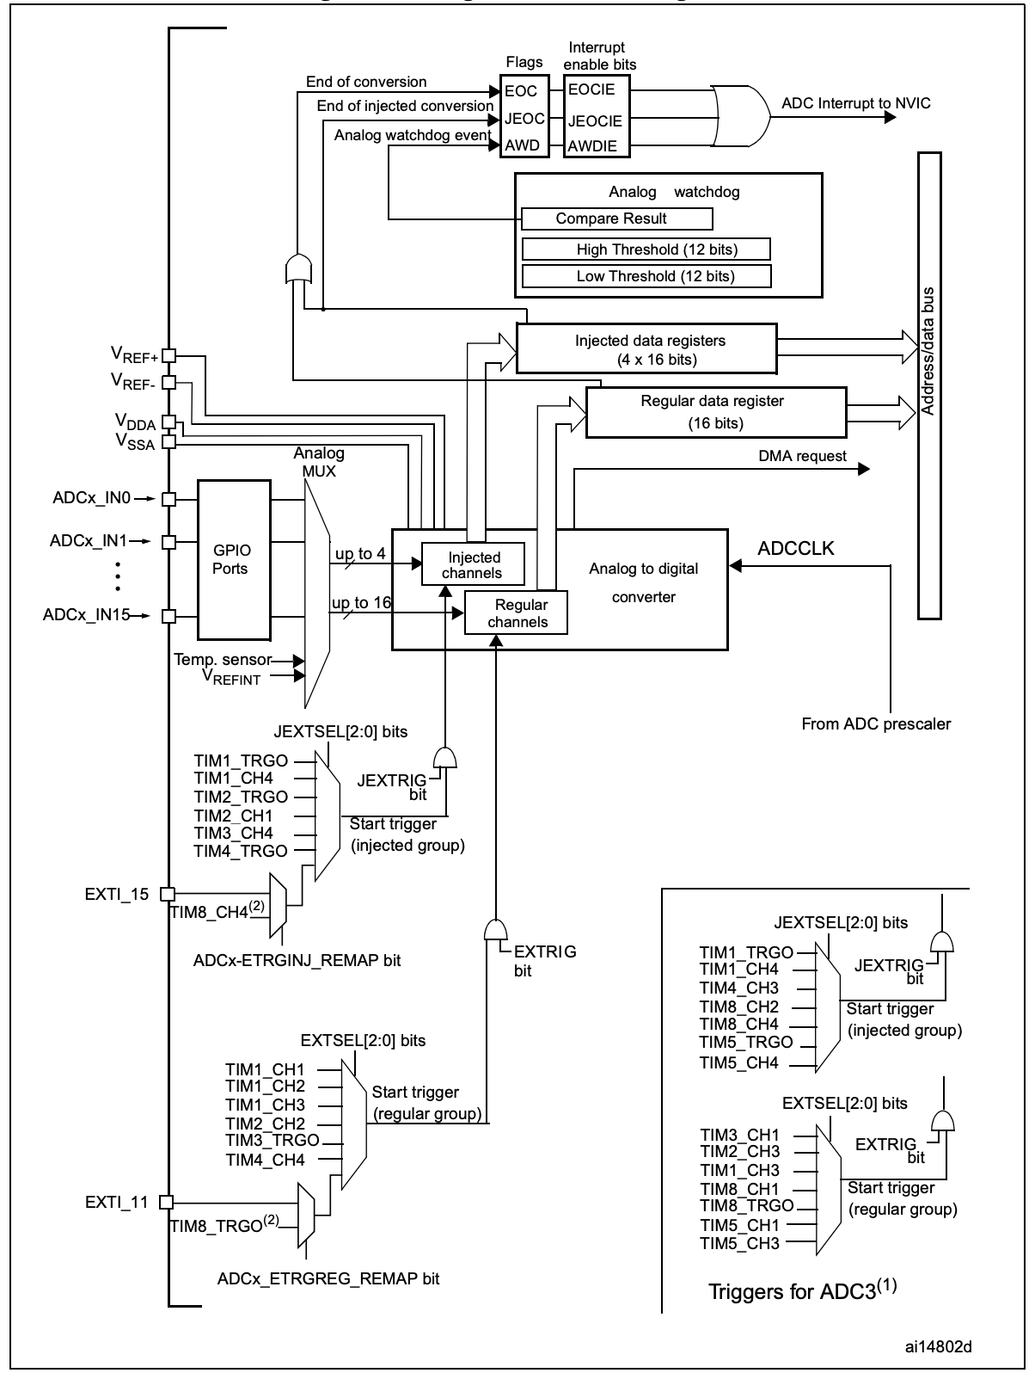
Single ADC block diagram

Slide 8
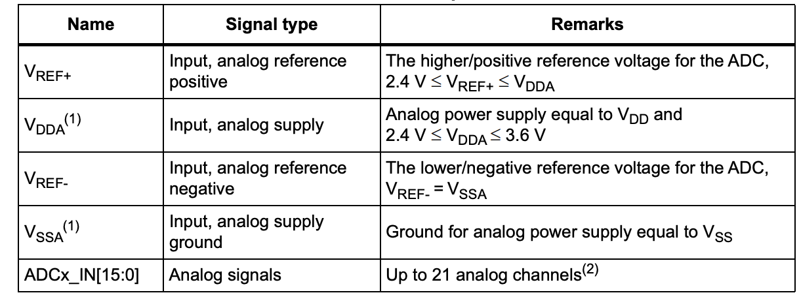
Table ADC pins

Slide 9
On-Off Control & Clock
Power-up: Controlled by ADON bit in ADC_CR2
Stabilization: Wait t_STAB after power-on before first conversion
Clock Source: ADCCLK = PCLK2 / Prescaler (/2, /4, /6, /8)
Constraint: ADCCLK ≤ 14 MHz for 12-bit accuracy

Slide 10
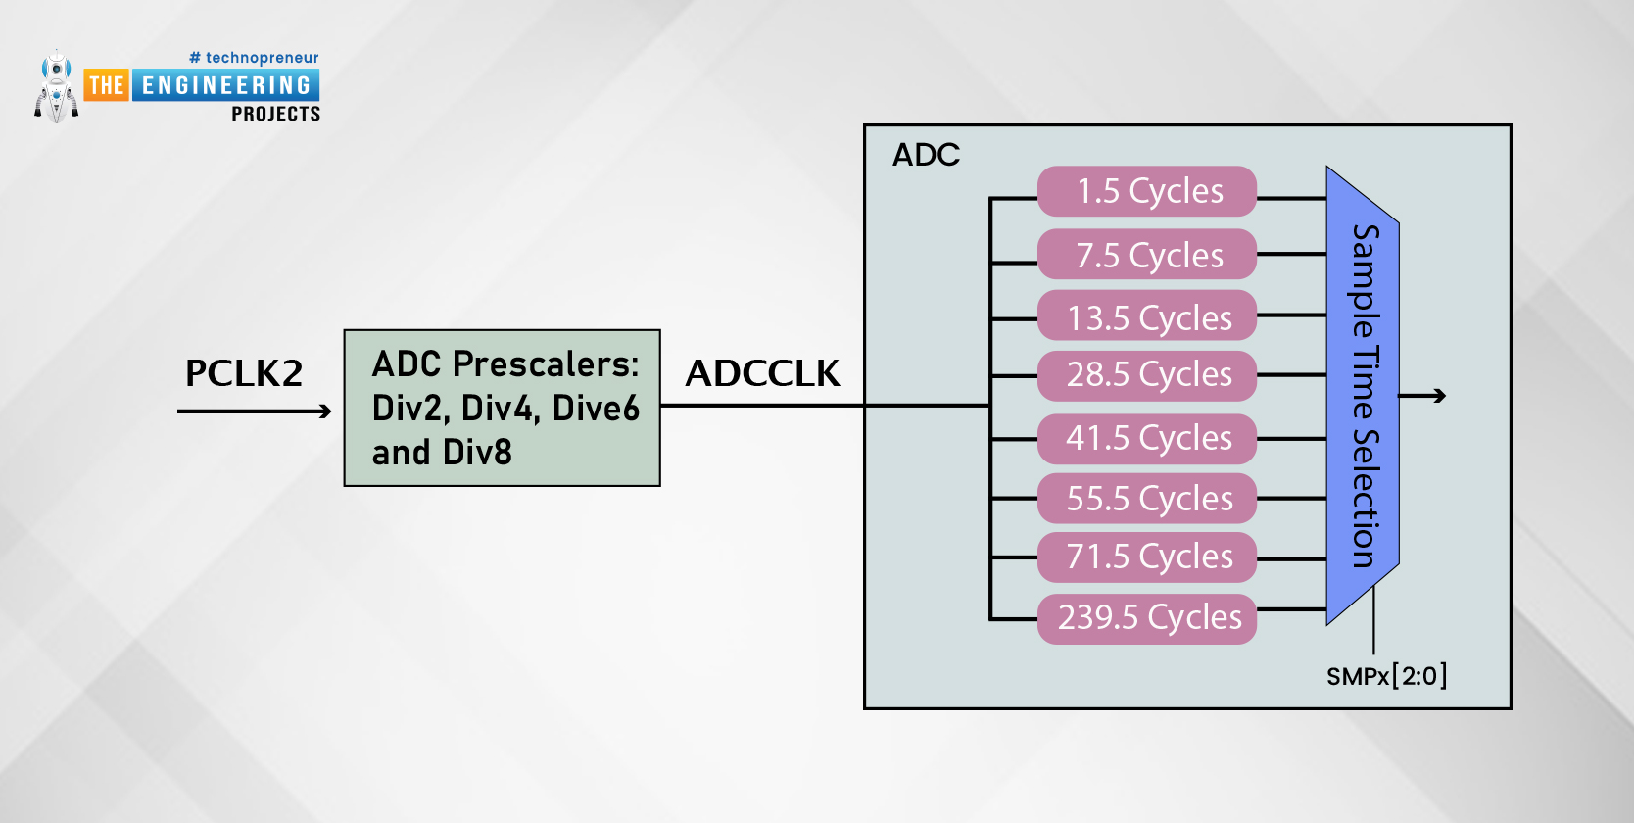
On-Off Control & Clock
Power-up: Controlled by ADON bit in ADC_CR2
Stabilization: Wait t_STAB after power-on before first conversion
Clock Source: ADCCLK = APB2 / Prescaler (/2, /4, /6, /8)
Constraint: ADCCLK ≤ 14 MHz for 12-bit accuracy

Slide 11
Channel Selection & Basic Modes
Channel Mapping: ADC_IN0 → ADC_IN15 + internal sensors
Single Conversion: Converts one channel, then stops
Continuous Conversion: Automatically converts the selected channel repeatedly
Scan Mode: Converts a programmed sequence of channels defined in ADC_SQRx
Discontinuous Mode: Converts the scan sequence in small groups; conversion pauses after a fixed number of channels and resumes on the next trigger

Slide 12
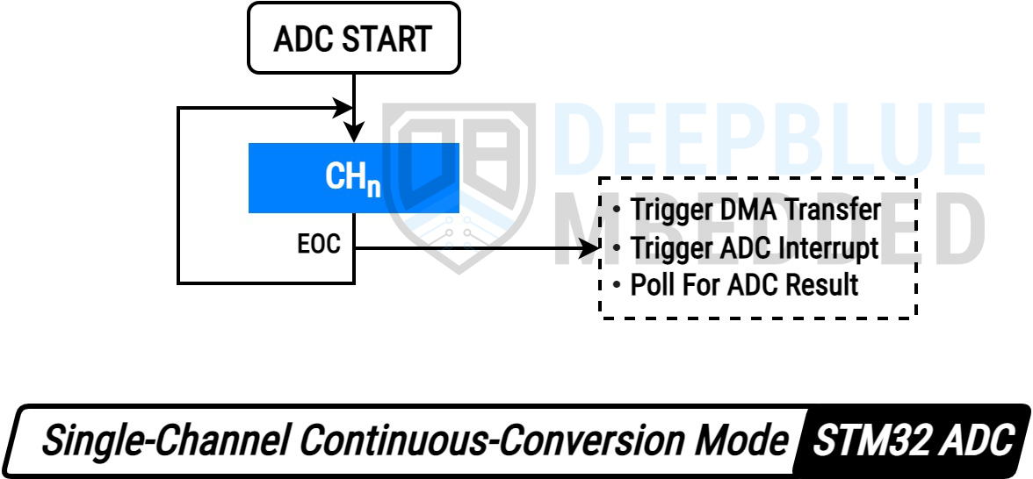

Slide 13
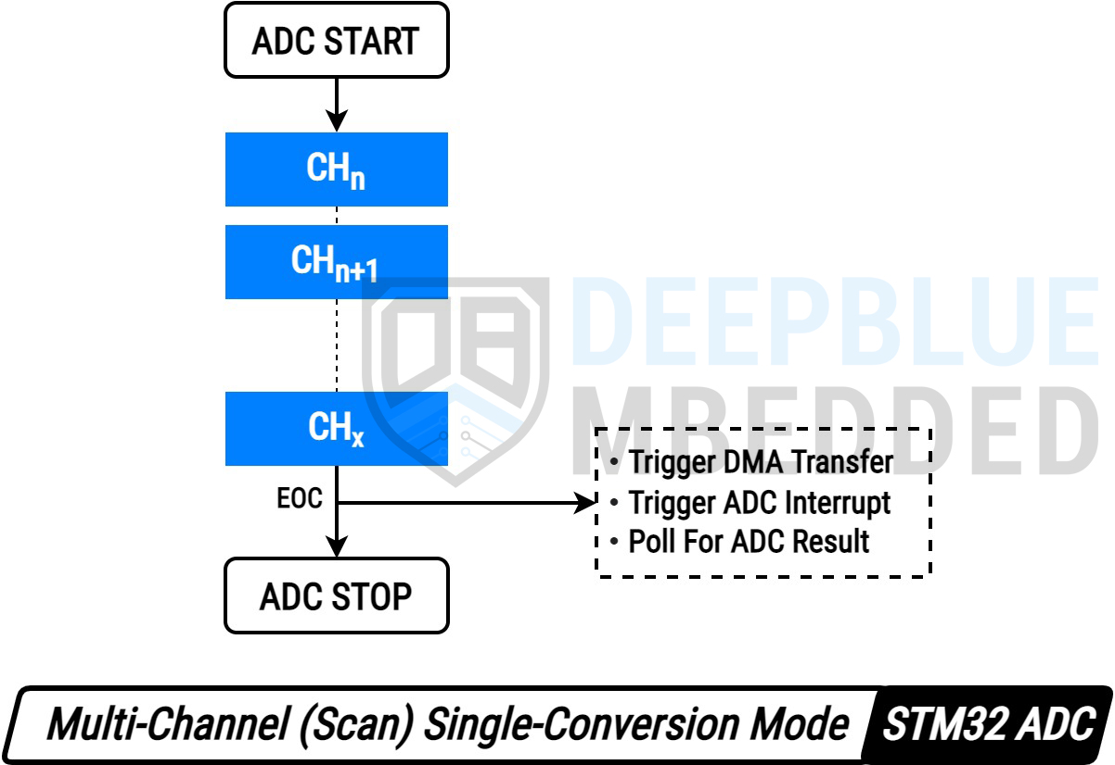

Slide 14
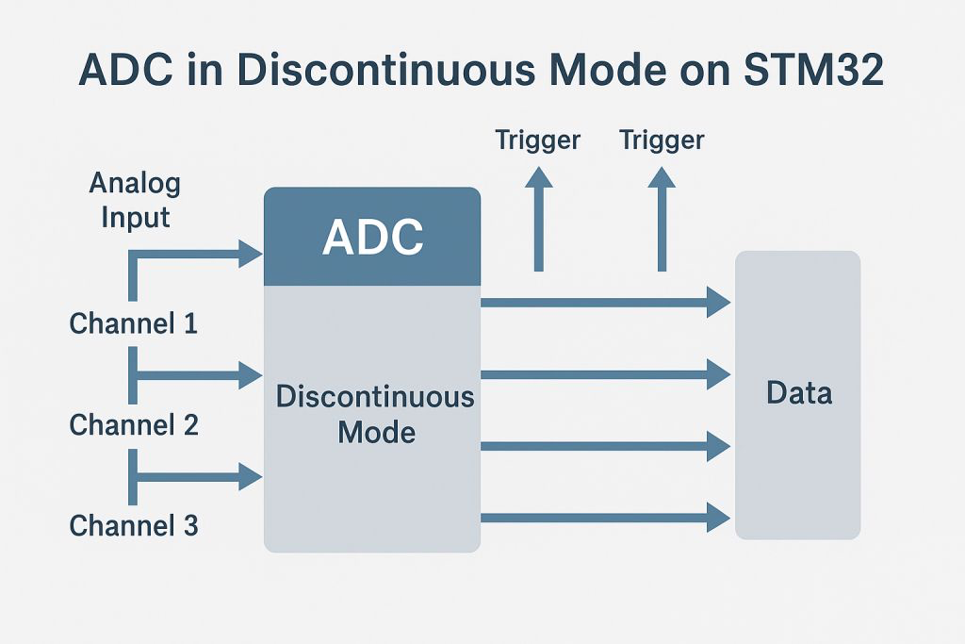

Slide 15
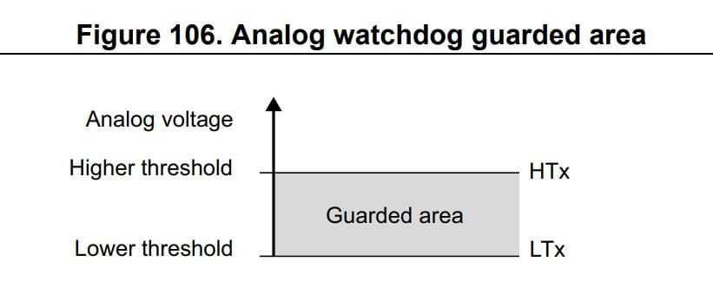
Analog Watchdog
Hardware feature of ADC for voltage monitoring
Uses Upper and Lower threshold limits
Continuously checks input voltage during conversion
Generates interrupt if voltage crosses limits
Used for safety and over/under-voltage detection

Slide 16
Injected Channels
Special ADC channels with higher priority
Can interrupt regular ADC conversions
Used for urgent or time-critical measurements
Results stored in injected data registers
Common in motor control and real-time systems

Slide 17
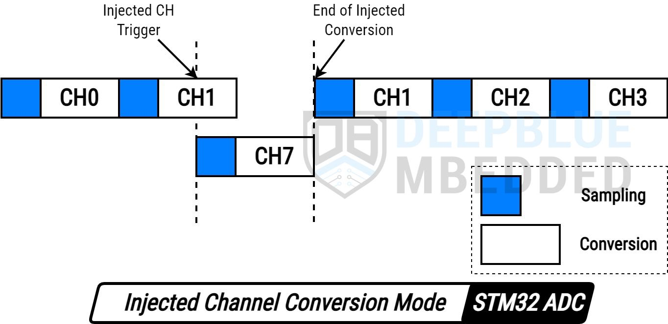
Injected Channels

Slide 18
Calibration
The STM32F103 ADC has built-in self-calibration.
Reduces errors from internal capacitor variations → improves accuracy.
How to start:
Set the CAL bit in ADC_CR2.
After calibration, CAL bit resets automatically → ADC ready for normal conversions.

Slide 19
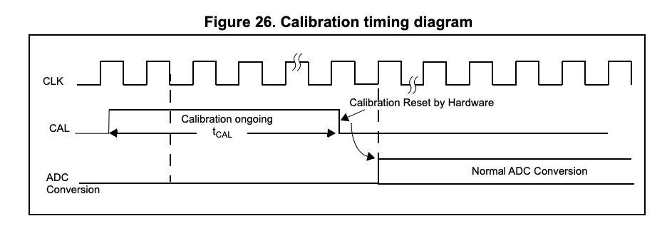
Calibration

Slide 20
Data Alignment
ALIGN bit (ADC_CR2) determines how conversion results are stored.
Right Alignment:
12-bit data → bits [11:0]
Ideal for standard 12-bit readings
Left Alignment:
12-bit data → bits [15:4]
Useful for 8-bit equivalent readings

Slide 21
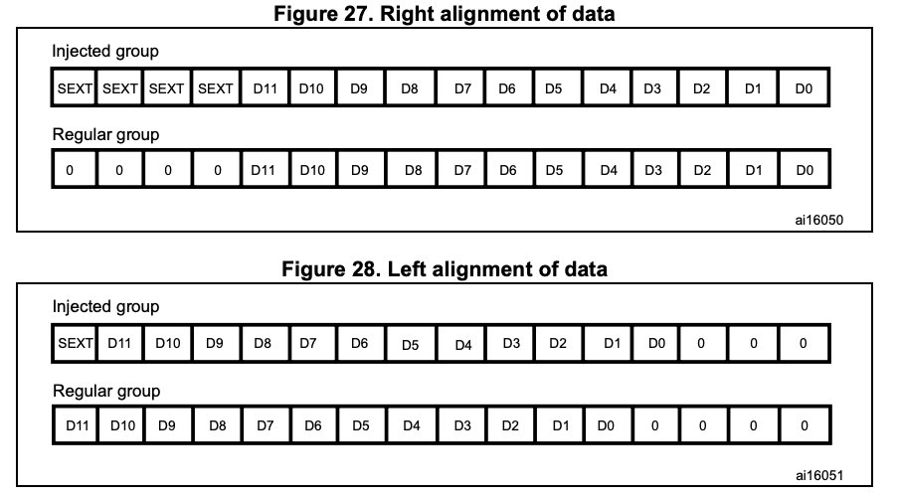
Data Alignment

Slide 22
Programmable Sample Time
Concept: Each ADC channel can have its own sampling time. The sampling time is controlled using SMP[2:0] bits in ADC_SMPR1 and ADC_SMPR2 registers.
Total Conversion Time: Tconv​=Sampling time+12.5 cycles
Example:
ADCCLK = 14 MHz
Sampling time = 1.5 cycles
Tconv = 1.5 + 12.5 = 14 cycles ≈ 1 µs
Sampling Cycles:
Programmable from 1.5 → 239.5 cycles per channel
Accuracy: Longer sampling → higher accuracy, especially for high-impedance sources

Slide 23
Methods to Read ADC Data
Method | CPU Load | Pros | Cons
Polling | High | Easy to implement | CPU waits, inefficient
Interrupt | Medium | CPU efficient, multi-task friendly | Slight overhead
DMA | Low | Continuous acquisition, high-speed | Setup complexity
DMA moves data directly to SRAM without CPU involvement
Ideal for real-time multi-channel acquisition

Slide 24
Sensor Interfacing & Internal Sensors
External Sensors: LM35 (Temp), LDR (Light), Potentiometers
Internal Temp Sensor: ADC_IN16 → monitor chip health
VREFINT: ADC_IN17 → calibration reference
Conversion Formula: VIN​=(ADC Value×VREF)/4095 ​​
Explanation:
V_IN: Measured input voltage
ADC Value: 12-bit ADC reading (0 → 4095)
V_REF: Reference voltage used by ADC
Example:
ADC Value = 2048
VREF = 3.3V
VIN​=(2048×3.3)/4095​≈1.65 V

Slide 25
STM32 ADC Register Map
1. Control Registers – ADC_CR1, ADC_CR2
Purpose: Configure ADC behavior
ADC_CR1 Key Bits:
SCAN: Scan mode enable
AWD: Analog watchdog enable
EOCIE: End-of-conversion interrupt enable
ADC_CR2 Key Bits:
ADON: ADC enable
CONT: Continuous conversion mode
DMA: DMA enable for ADC data transfer
ALIGN: Data alignment (Right/Left)
2. Status Register – ADC_SR
Purpose: Indicates ADC status and events
Key Flags:
EOC: End of conversion
AWD: Analog watchdog triggered
JEOC: End of injected conversion
OVR: Overrun flag

Slide 26
3. Data Registers
Regular Data: ADC_DR
Stores result of regular channel conversion
12-bit value (0–4095)
Injected Data: ADC_JDRx
Stores result of injected channel conversion
Useful for priority conversions

Slide 27
Applications of STM32 ADC
Temperature sensing (LM35, TMP36)
Light / Gas sensors (LDR, MQ-series)
Battery voltage monitoring
IoT data acquisition
Real-time embedded systems
Limitations
No DAC output
Sensitive to noise → proper grounding required
Dependent on VREF stability
Limited sampling speed compared to higher-end MCUs

Slide 28
Thank you

